Slide 1
Lab 4 Conditional Statements in C
By Sumaiyah Zahid

Slide 2
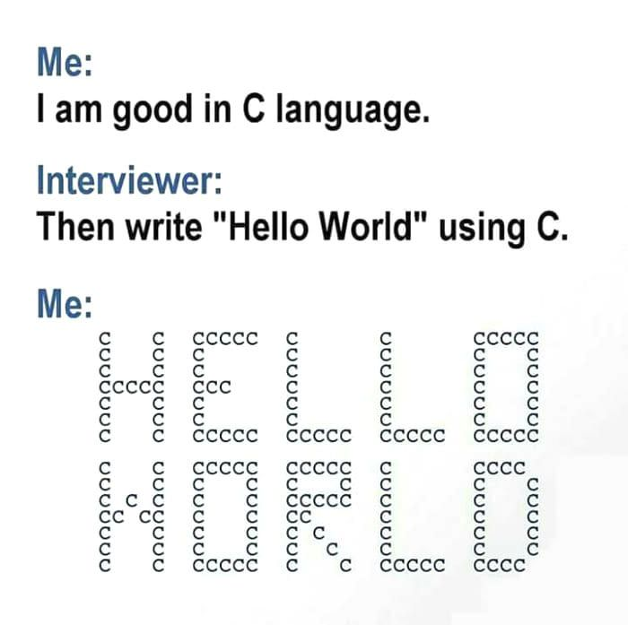

Slide 3


Slide 4


Slide 5
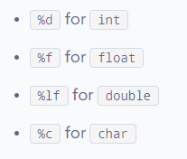
Scanf statment
#include <stdio.h>
int main()
{
int a;
float b;
printf("Enter integer and then a float: ");
// Taking multiple inputs
scanf("%d%f", &a, &b);
printf("You entered %d and %f", a, b);
return 0;
}

Slide 6
Scanf statment
#include <stdio.h>
int main()
{
char chr;
printf("Enter a character: ");
scanf("%c", &chr);
// When %c is used, a character is displayed
printf("You entered %c.\n",chr);
// When %d is used, ASCII value is displayed
printf("ASCII value is %d.", chr);
return 0;
}

Slide 7
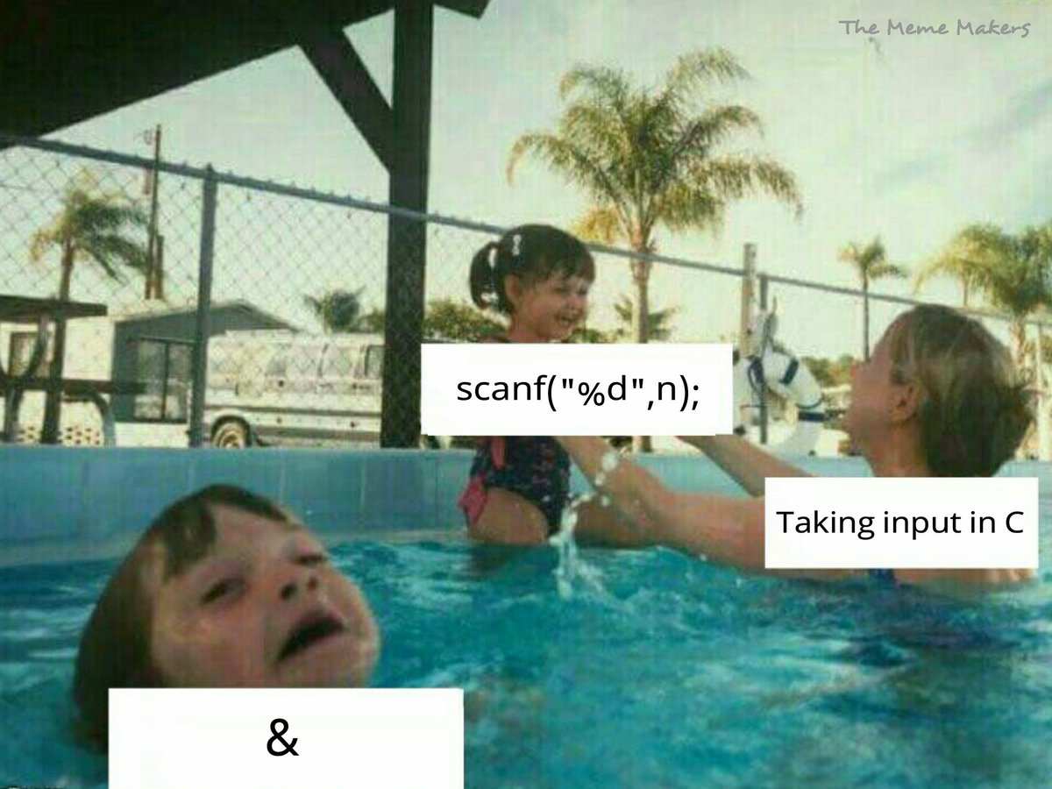

Slide 8


Slide 9
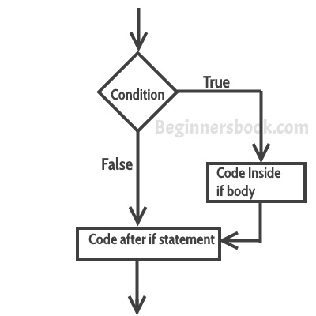
If Statment
#include<stdio.h>
int main(){
int num=0;
printf("enter the number");
scanf("%d",&num);
if(num%2==0)
{
printf("%d number is even",num);
}
return 0;
}

Slide 10
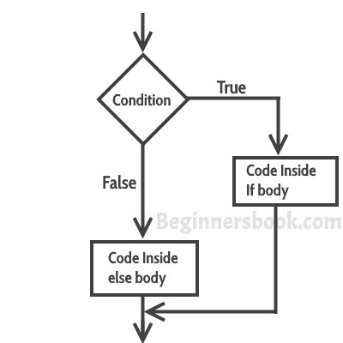
If Else Statment
#include<stdio.h>
int main(){
int num=0;
printf("enter the number");
scanf("%d",&num);
if(num%2==0)
{
printf("%d number is even",num);
}
else
{
printf("%d number is odd",num);
}
return 0;
}

Slide 11
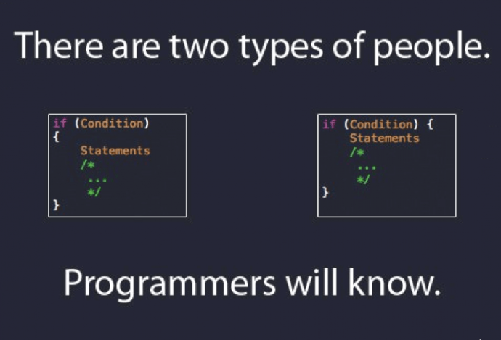

Slide 12
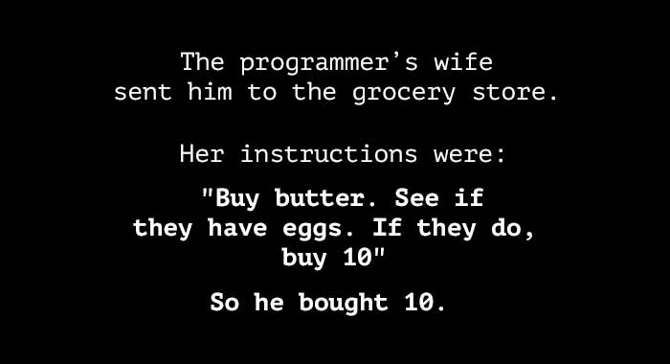

Slide 13
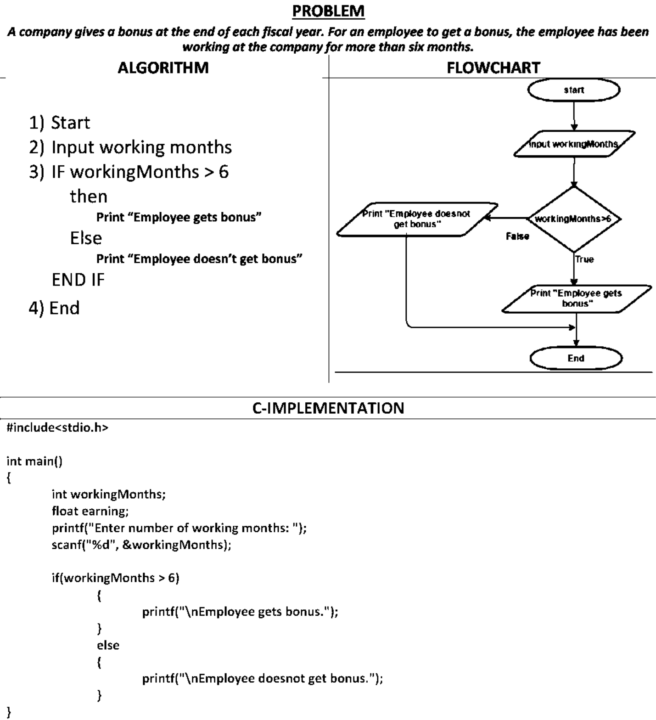
If Else

Slide 14
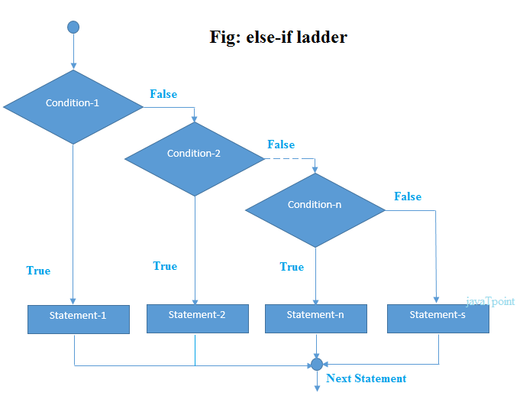
If- Else If Statment
if (expression1)
statement 1;
else if (expression 2)
statement 2;
...
else
statement n;

Slide 15
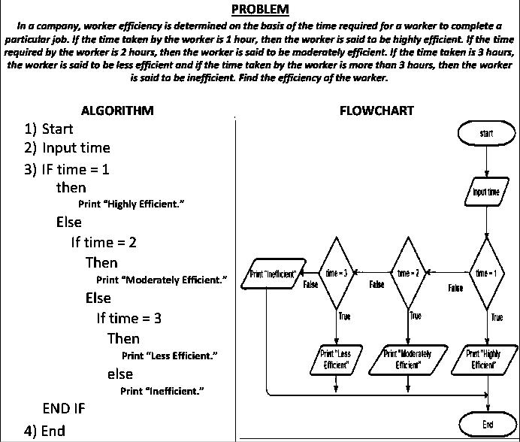

Slide 16
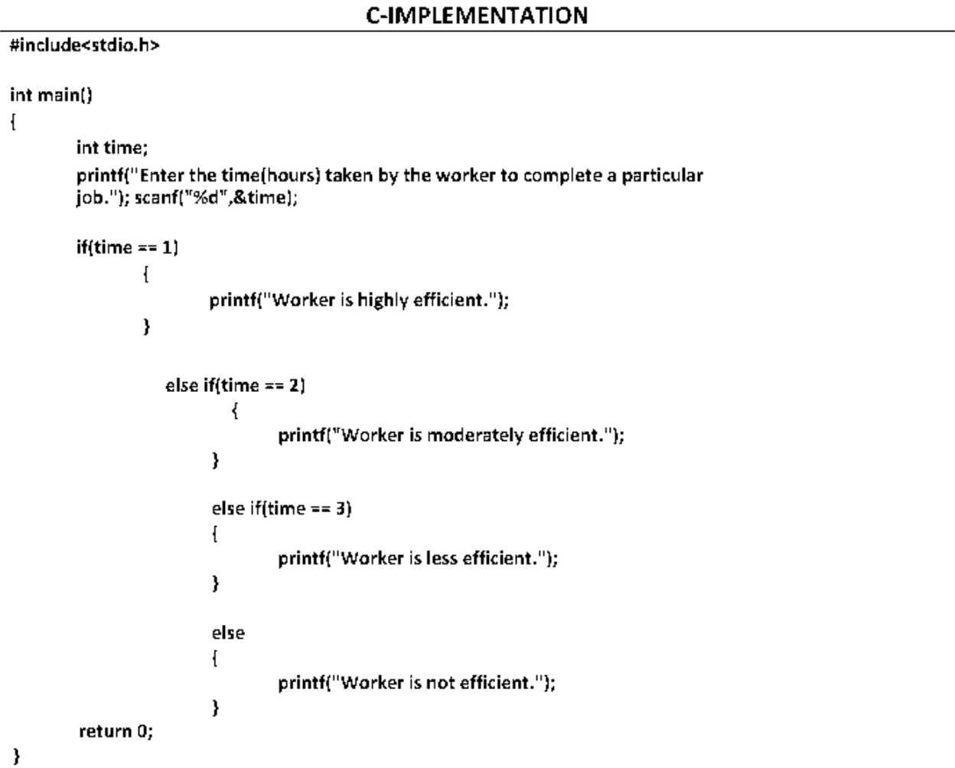

Slide 17
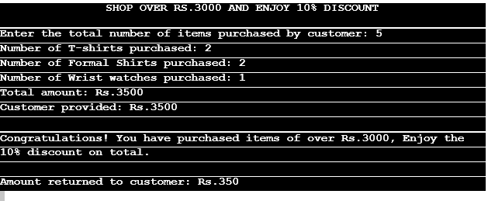
Lab activity
1. Generate the following output:
For help: Unit price of T-shirt is Rs.500, Formal Shirt is Rs.1000 and Wrist Watch is Rs.500
2. Based on user input, check whether the given character is an alphabet, digit or special character.
3. Write a program to determine fare. Rs 20 for a child, who is not more than 11 years old, for adult Rs 50 and Rs 30 for an aged person of at least 65 years’ old.

Slide 18
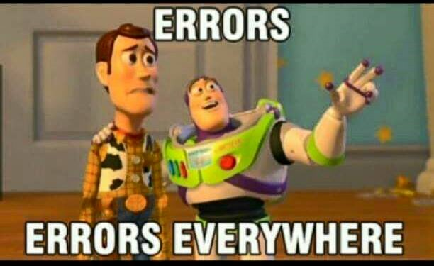

Slide 19
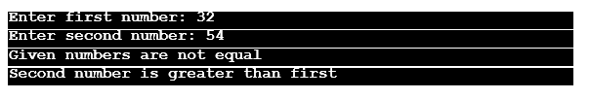

4. Input two numbers and determine whether the numbers are equal or not, if numbers are not equal then determine which one is greater and which one is less.
5. The body mass index (BMI) is the ratio of the weight of a person (in kilograms) to the square of the height (in meters). Write a program that takes two inputs, weight and height, computes the BMI, and prints the corresponding BMI category:
Starvation: less than 15
Underweight: less than 18.5
Ideal: greater than or equal to 18.5 but less than 25
Overweight: greater than or equal to 25 but less than 30
Morbidly Obese: greater than or equal to 40
6. Write a program to input your age and your sister’s age and then display who is older of the two.

